Slide 1
How our own taxonomic database works and how we use it?
Team of China Node
16-02-2010, Faro, Portugal

Slide 2
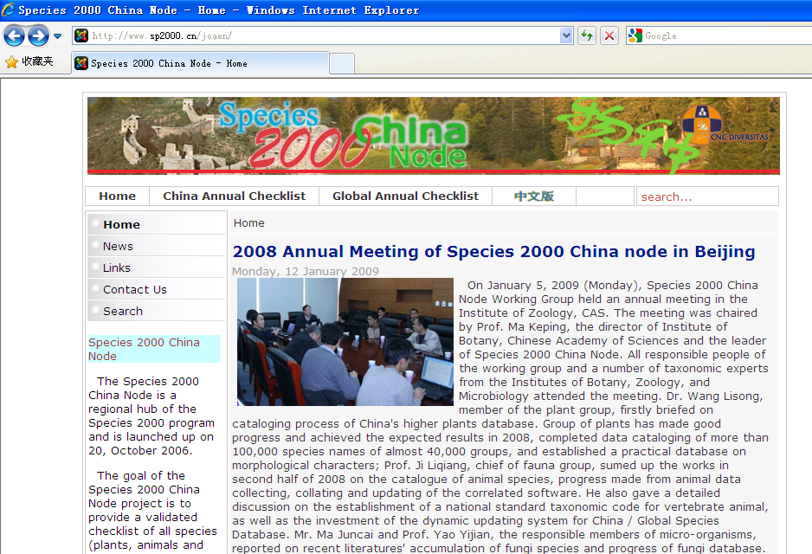

Species 2000 China Node

Slide 3
Taxonomic Database (1)
Basic data of a species:
Accepted name
Synonym
Common name
Distribution
Family name
References
……
Catalogue of Life, China

Slide 4
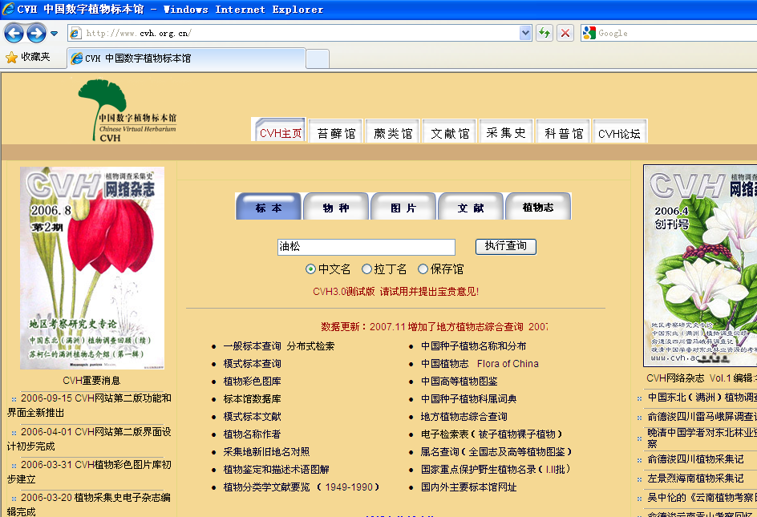
Chinese Virtual Herbarium

Slide 5
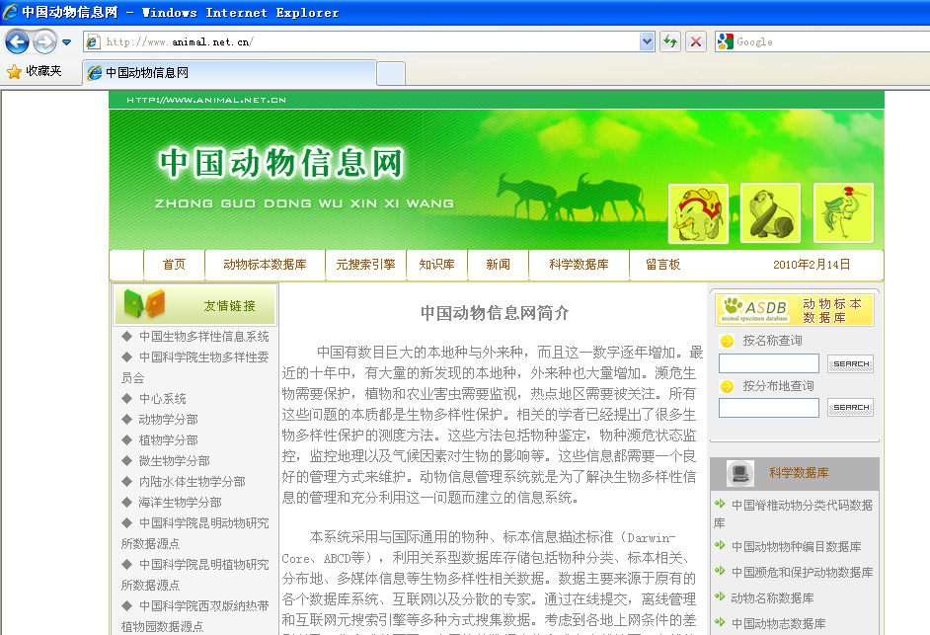
Chinese Animal Information System

Slide 6
Taxonomic Database (3)
Chinese Virtual Herbarium (CVH)
Chinese Animal Information System (CAIS)
…………
Data of species, specimen, literature, photo, curator, museum/institution, etc.
Disciplinary Integrated Database/System

Slide 7
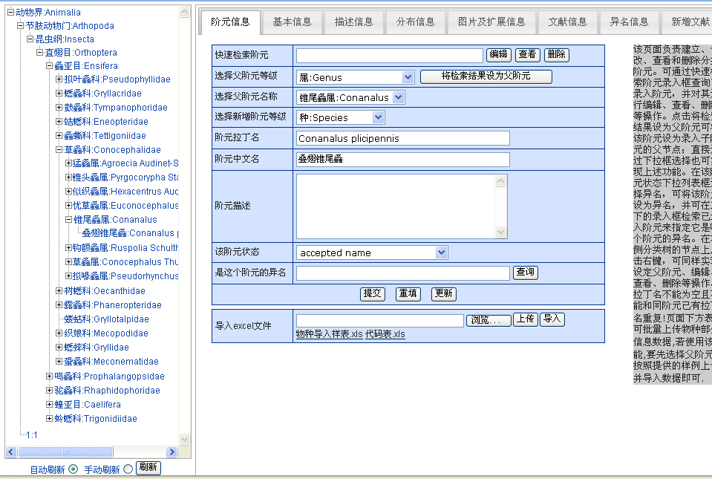
Chinese Orthopter Species Database

Slide 8
Taxonomic Database (3)
Chinese Orthopter Species Database
Chinese Amphibian Species Database
Chinese Reptile Species Database
Chinese Bee Species Database
Chinese Spider Species Database
…………
Chinese Species Database

Slide 9



How taxonomic database work (1)
Website manager
COL China, Annual Checklist
public
Harvest/import
Taxonomist,
curator,
Data manager
Disciplinary integrated database/system
public
import
taxonomist
Chinese species database

Slide 10
How taxonomic database work (2)
COL China,
Dynamic
Checklist
public
Web Service
Disciplinary integrated database/system
Import with
xml file
Data manager
Chinese species database

Slide 11
How taxonomic database work (3)
Operating system/database management system/web server/server program
Linux CentOS, MySQL, Apache, PHP
Microsoft Windows Server, SQL server, IIS, ASP
Microsoft Windows Server, MS access, Tomcat, PHP
…………

Slide 12
How to use taxonomic database (1)
Now:
Query or search on the website

Slide 13
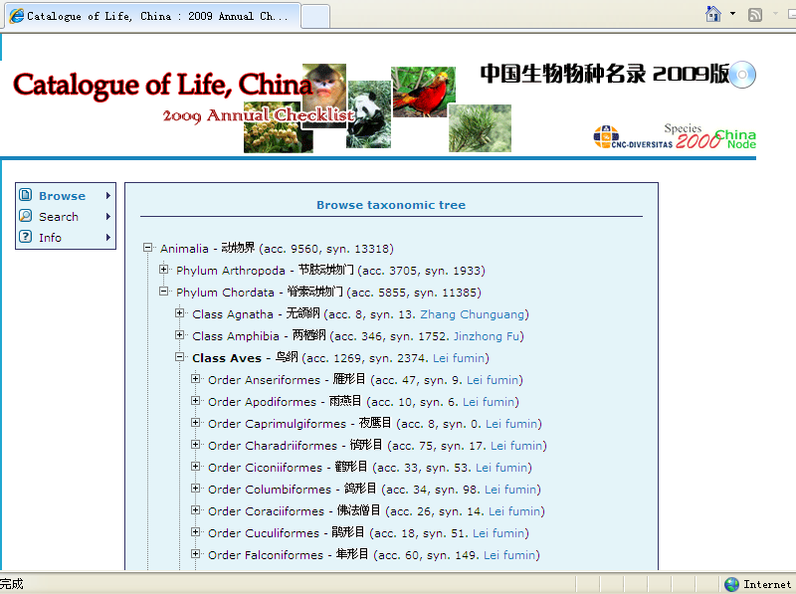
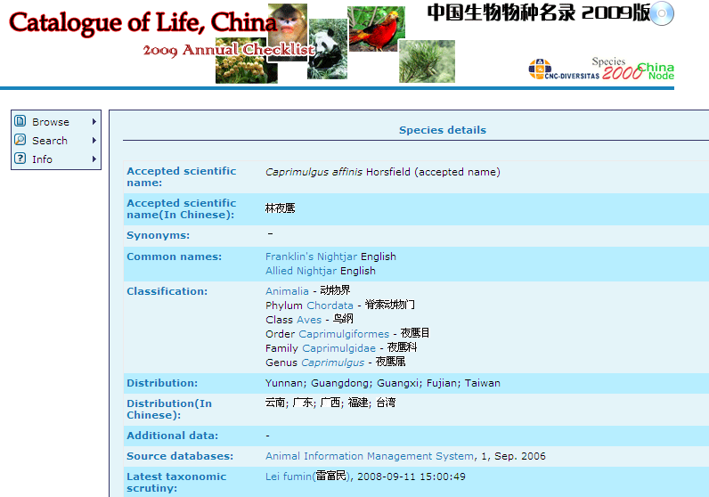
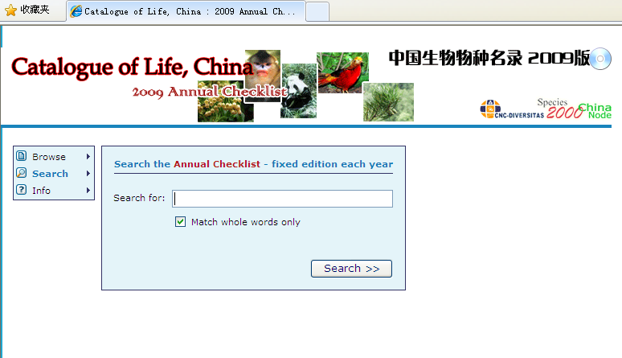
Query or search on the website

Slide 14
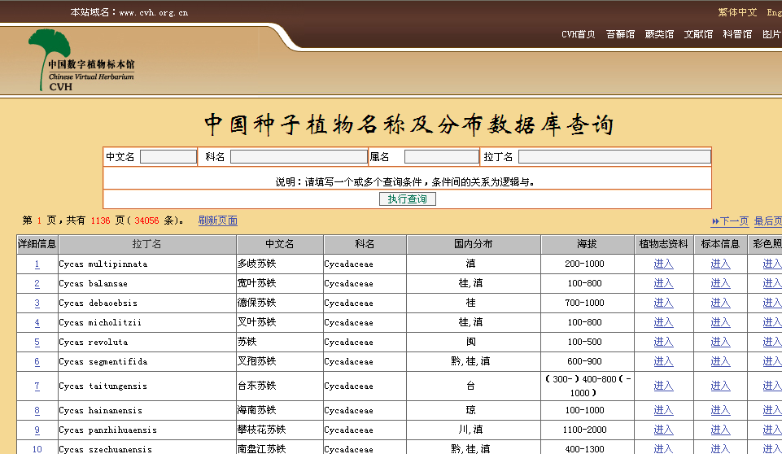
Query or search on the website

Slide 15
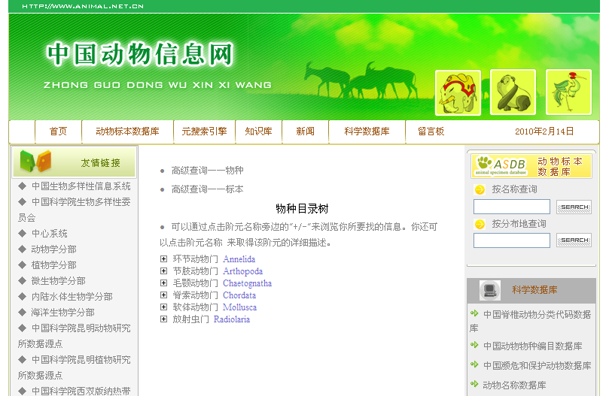
Query or search on the website

Slide 16
How to use taxonomic database (2)
2 months later:
Get data from COL China via web service

Slide 17
Web services to be provided
An example of web service: get a family name by HTTP POST
Send request
POST /colchinatools/service1.asmx/getfamilyname HTTP/1.1
Host: 159.226.67.3
Content-Type: application/x-www-form-urlencoded
Content-Length: length
genusname=string
Get result
HTTP/1.1 200 OK
Content-Type: text/xml; charset=utf-8
Content-Length: length
<?xml version="1.0" encoding="utf-8"?>
<string xmlns="http://webservice.sp2000.cn/colchinainfo/">string</string>

Slide 18
Web services to be provided
Species data: get full data set of a species by inputting accepted name or synonym;
Higher rank data: get the taxon name that a taxon belong to;
Lower rank data: get the taxa name(s) belonged to an taxon;
Checklist of a family: download the checklist of a family by a family name;
Name validation: check if a name is a valid name (accepted name, synonym or common name) in our checklist or not. If not, evaluate the possibility that the name is misprinting or different suffix.

Slide 19
How to use taxonomic database (3)
By the end of 2010:
Taxonomic data analysis: checklist comparison, etc.

Slide 20
checklist comparison (1)
Family X
Family X
Genus 1-A
Genus 1-B
Genus 1-C
Genus 2-A
Genus 2-B
Genus 2-C
S1-1
S1-2
S1-3
S1-4
S1-5
S2-I
S2-2
S2-3
S2-4
S2-5
Checklist 1
Checklist 2

Slide 21
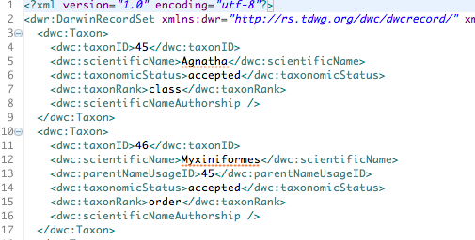
checklist comparison (2)
Input format 1: xml files with the Darwin Core schema

Slide 22
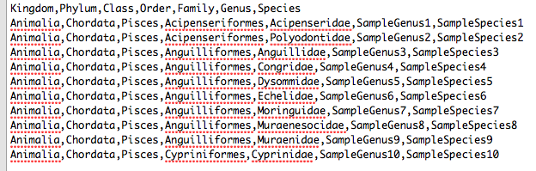
checklist comparison (3)
Input format 2: csv files

Slide 23
checklist comparison (4)
Comparison result for user:
an xml file
a chart
Family X
Genus A
Genus B
Genus C
SI
S2-2
S1-2
S3
S4
S5

Slide 24

Thank you for your attention
HAPPY
TIGER
YEAR
Species 2000 China Node:
Keping Ma (kpma@ibcas.ac.cn)
Liqiang Ji (ji@ioz.ac.cn)

